Slide 1

Credit Card Fraud Detection

Slide 2
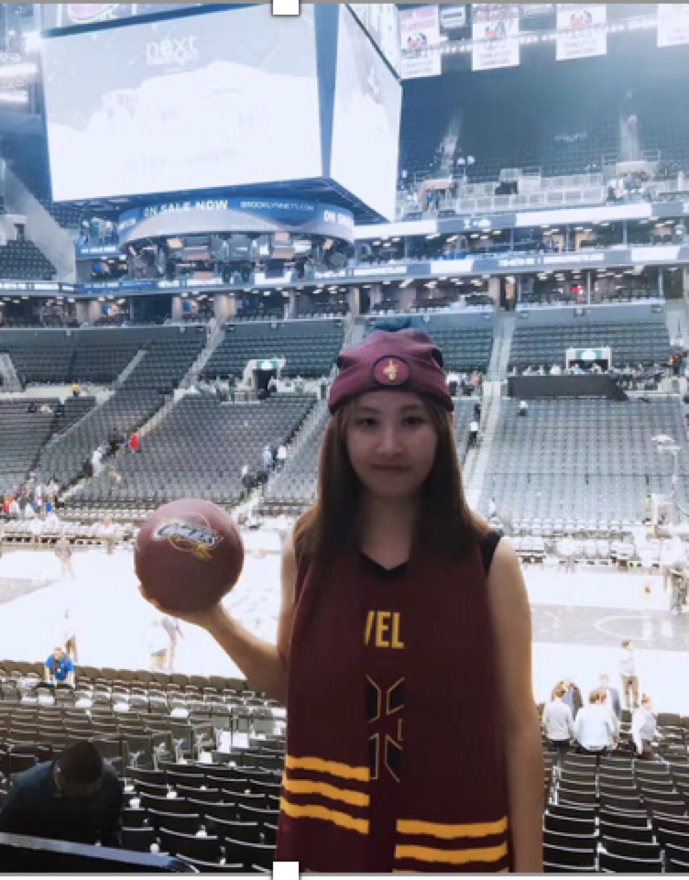



TEAM MEMBER
Lulu Hu Sicong Wang Yiting Ren Yaoning Mo

Slide 3

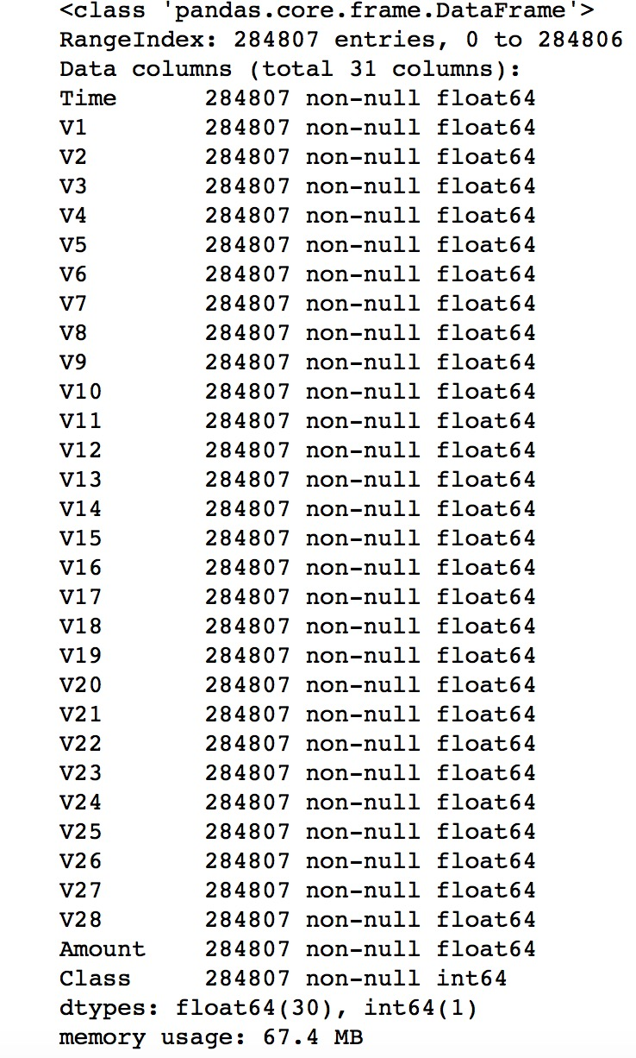
DATASET
BACKGROUND:BACKGROUND: According to FBI Trade Commission, credit card fraud has increased by 20 percent in couple of years ago, which has resulted in huge financial losses as the fraudulent transactions have been large value transactions. So it is important that credit card companies are able to recognize fraudulent credit card transactions so that customers are not charged for items that they did not purchase.
DATASET SOURCE: https://www.kaggle.com/mlg-ulb/creditcardfraud
The datasets contains transactions made by credit cards in September
2013 by European cardholders.
DATA INFORMATION: 284,807 observations 31 variables
OUR GOAL: In our project we build different models which are used to predict the probability of credit card fraud case by analyzing dataset, in order to prevent credit card fraud crime.

Slide 4
WHAT WE DO
Step 3
MODEL SELECTION
Step 2
DATE EXPLOARATION
Step 4
MODEL DIAGNOSIS
Step 1
DATA PROCESSING
Step 5
MODEL CORRECTION

Slide 5
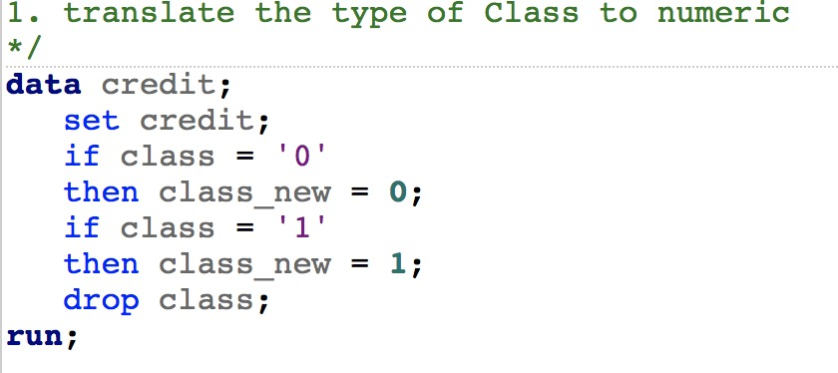
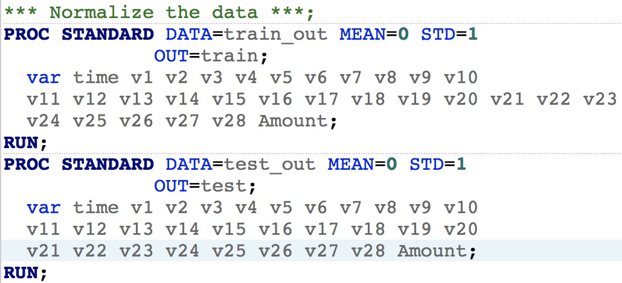
DATA PROCESSING
Convert Char Type of Variable Class to Numeric
STEP 1
STEP 2
Class Balance
Total 284,807 observations : class = 1 (492); class =0 (284315)
Because the dataset has 492 frauds out of 284,807 transactions. The dataset is highly unbalanced, the positive class (frauds) account for 0.172% of all transactions.
STEPS:
Distribute dataset (class = 0,1)
Pick 10% samples from the first dataset(class = 0) – File one
Replicate 10 files (class = 1) - File two (oversampling)
Combine File one & File two
Normalize Dataset
STEP 3

Slide 6
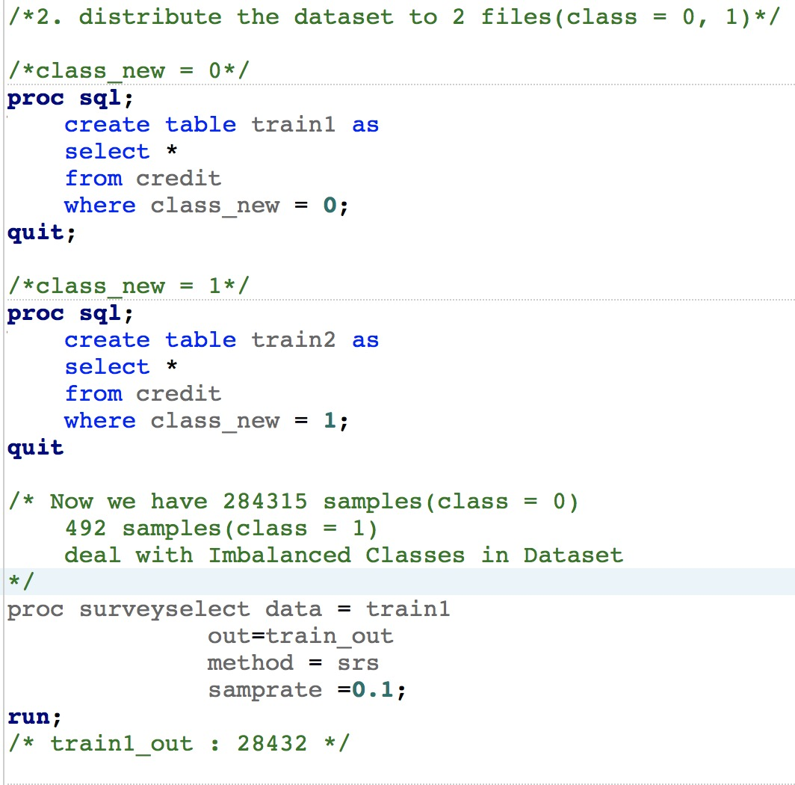
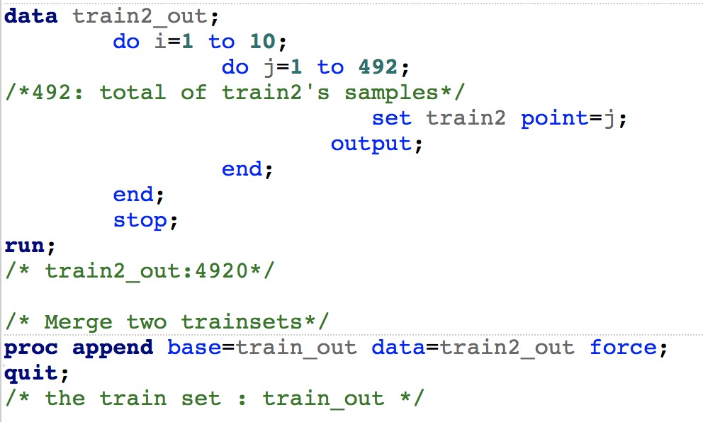
Class Balance
We create the test set by using same method like picking 10% form the file class = 0 as samples and we combine it and file class=1 into test set.
The final train set: 33,352 observations
The final test set: 28,924 observations

Slide 7

DATA EXPLORATION
Univariate Analysis
Correlation
PCA

Slide 8


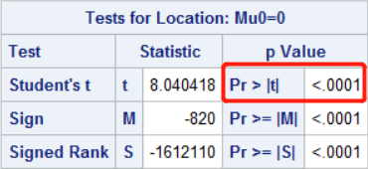
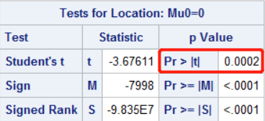
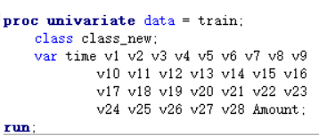
Univariate Analysis
Result of univariate analysis
We found that the p values were less than 0.05, which means the residuals are normally distributed. And that was also what we wanted.

Slide 9
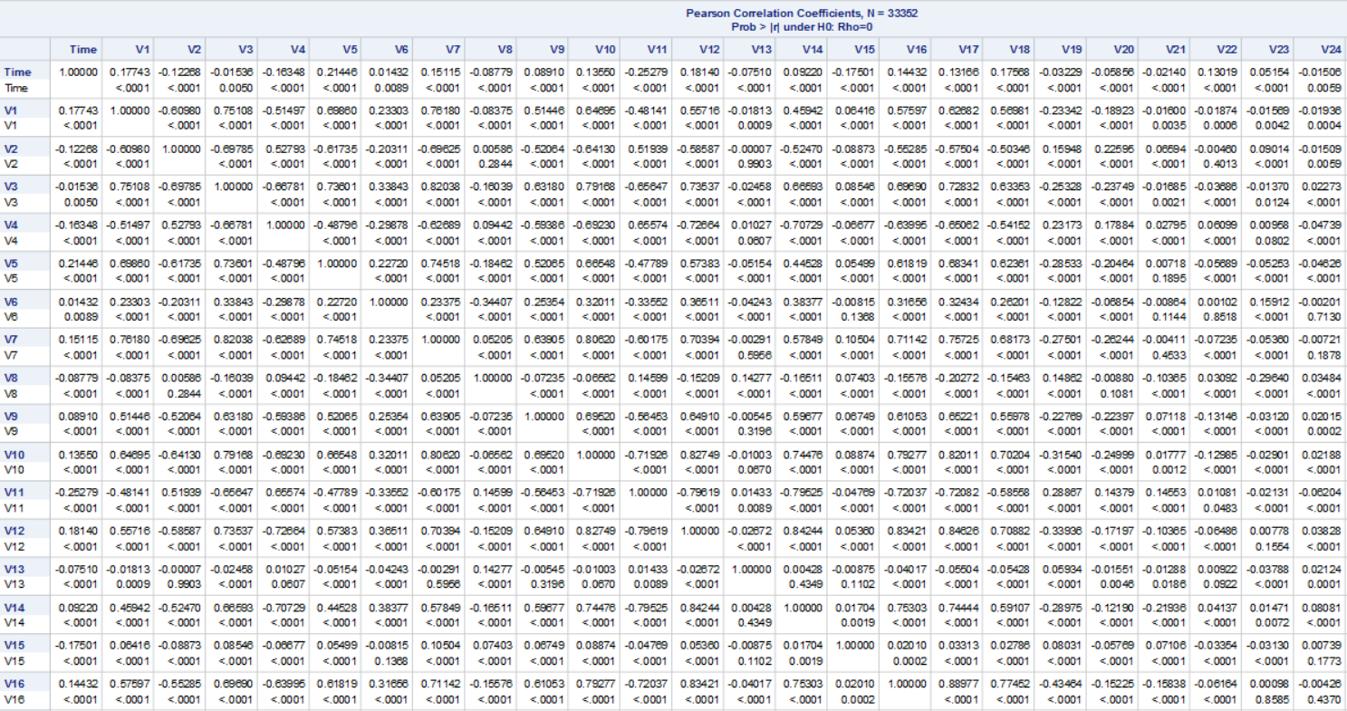
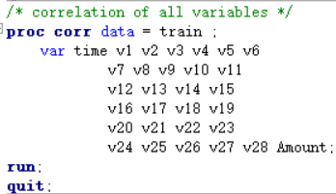
Correlation
Result:
We found that the correlation between variables were really complex, so at this point we did not remove any other values.

Slide 10
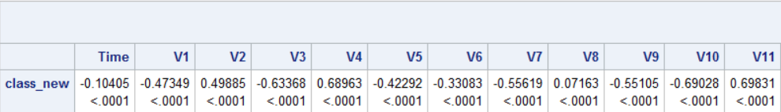
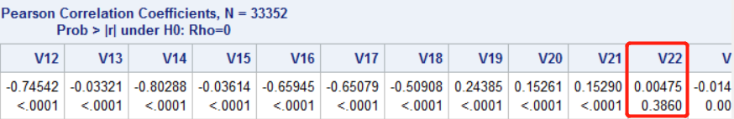
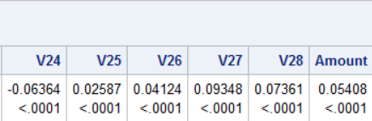
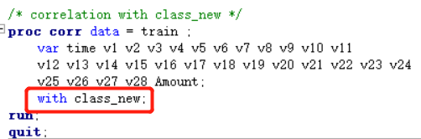
Correlation
Result:
We found that most of the variables had correlation with the class_new value except the v22. As a result, we removed the v22, then continued our work.

Slide 11
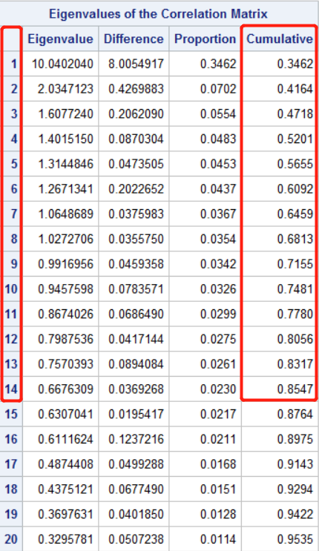
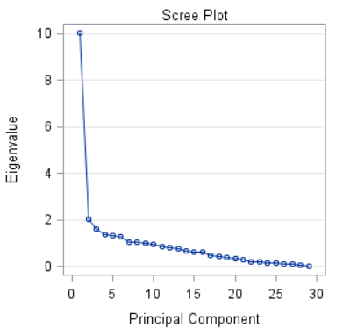
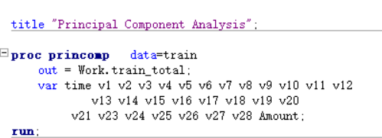
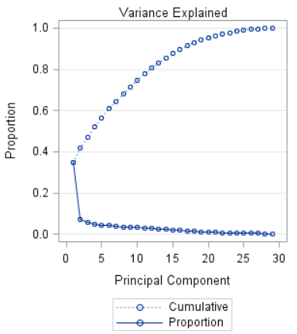
Principal Component Analysis
Result:
We can see that the first 14 components could explain more than 85% of our raw data from the table. So, we only took into account these 14 components and dropped anther 16 components => Lower dimension

Slide 12

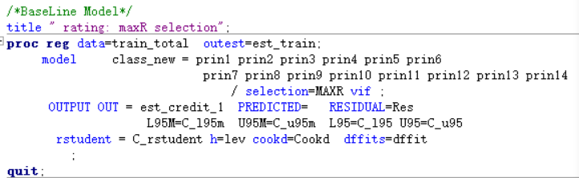
MODEL SELECTION
Image Place Holder
MULTIPLE REGRESSION

Slide 13
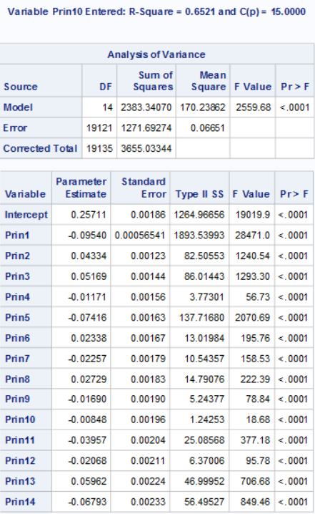
BASELINE MODEL
Cp criterion
Model：
P = 0.25711 - 0.09540 * prin1 + 0.04334 * prin2 + 0.05169 * prin3-0.01171*prin4
- 0.07416 * prin5+0.02338*prin6 -0.02257*prin7+0.02729*prin8-0.01690*prin9-0.00848*prin10
-0.03957*prin11-0.02068*prin12 +0.05962*prin13- 0.06793 * prin14
The Model F statistic is significant (<0.0001), indicating that the model accounts for a significant portion of variation in the data.

Slide 14
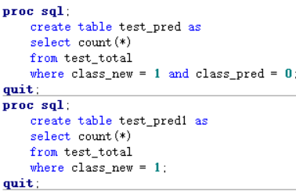
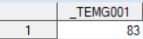
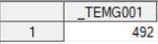
BASELINE MODEL
From the result we get the model formula and apply it to the test model to detect the accuracy
class_new = 1 and class_pred=0 83
class_new=1 492
accuracy : 83.13%
83.13%

Slide 15
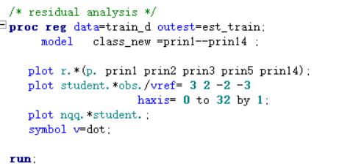
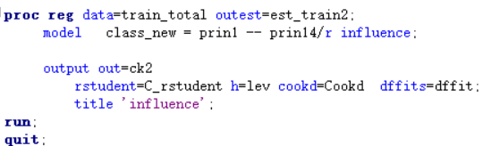
MODEL DIAGNOSIS
Residual Analysis
Influential Observations

Slide 16
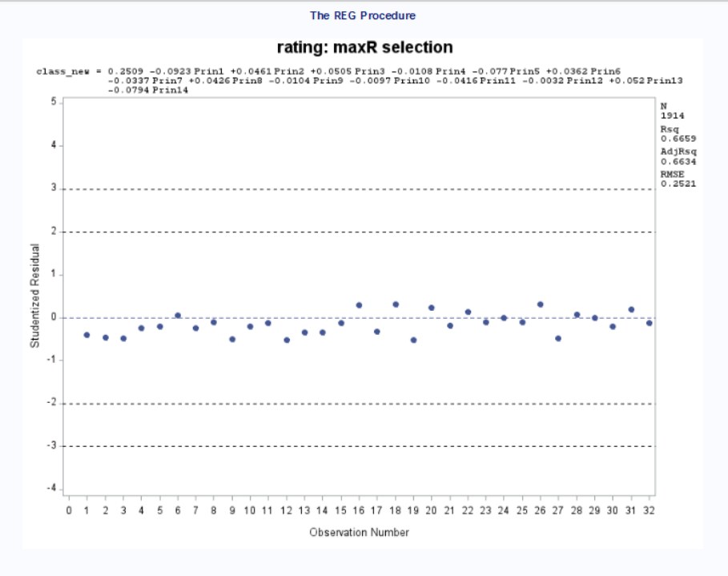
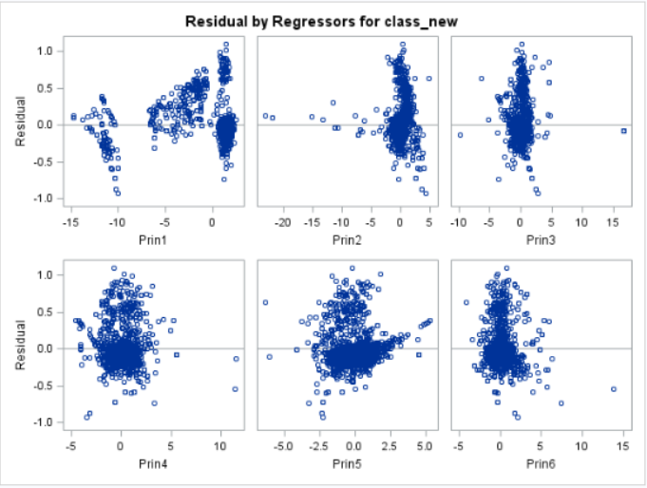
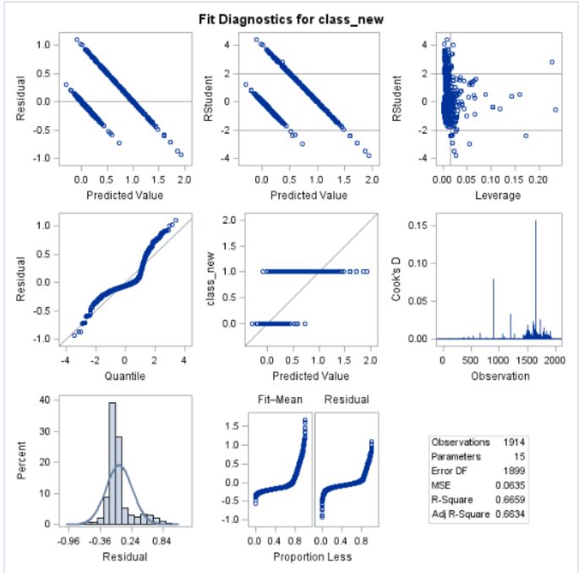
Residual Analysis Result

Slide 17

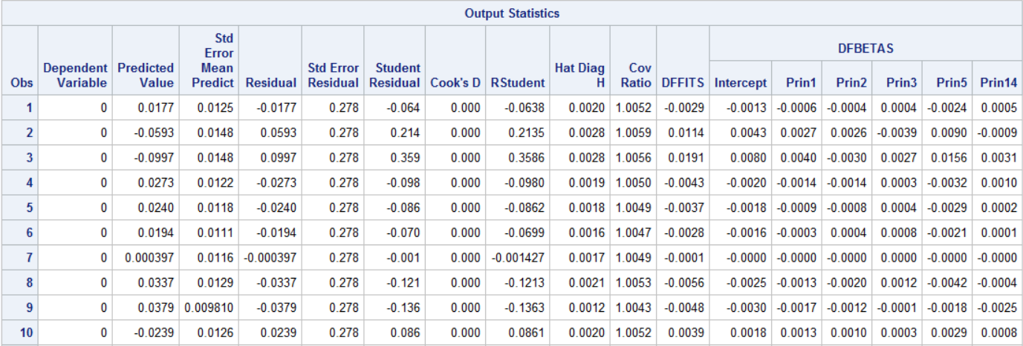
Influential Observation
WEB DESIGN

Slide 18
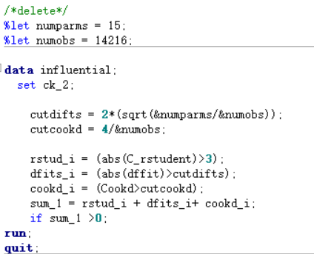
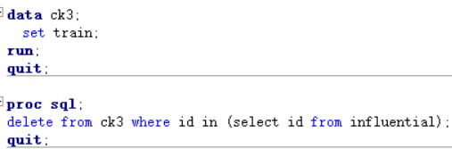
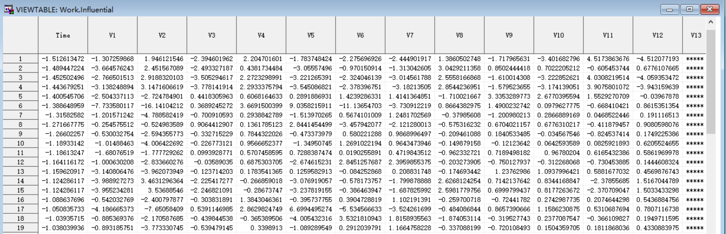
Find out influence case
Lid est laborum dolo rumes fugats untras. Etharums ser quidem rerum facilis dolores nemis omnis fugats vitaes nemo minima rerums unsers sadips amets..
Sed ut perspiciatis unde omnis iste natus error sit voluptatem.
SINGLE NEWS LAYOUT

Slide 19

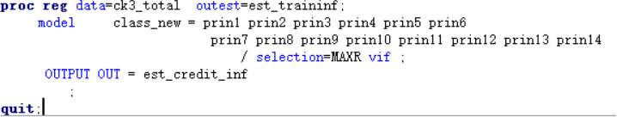
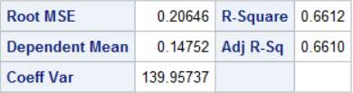
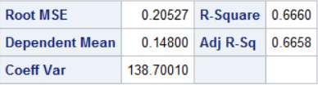
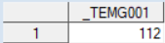
MODEL CORRECTION

BASELINE
IMPROVE
Image Place Holder
From the result we get the model formula and apply it to the test model to detect the accuracy
class_new = 1 and class_pred=0 112
class_new=1 492
accuracy : 77.23%
77.32%

Slide 20
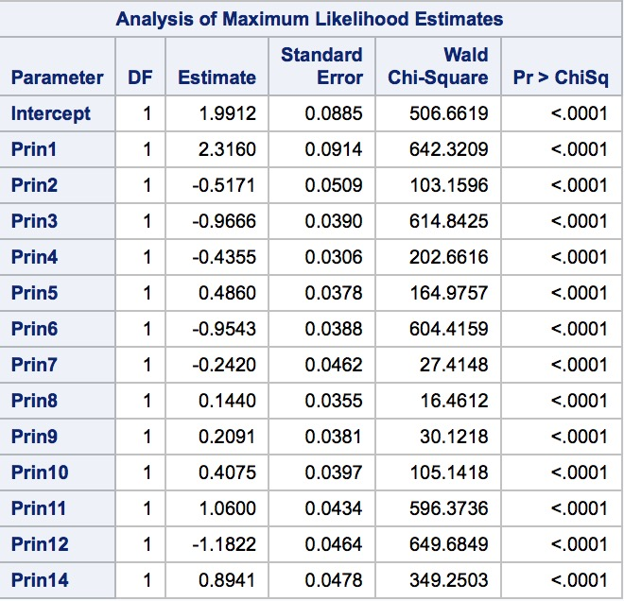
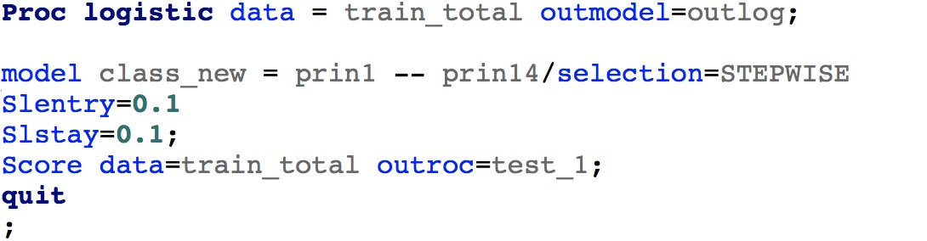
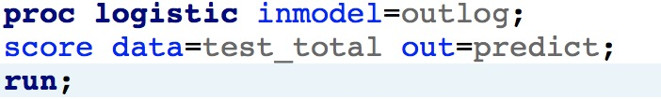
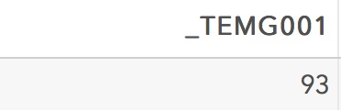
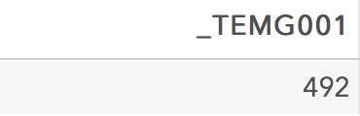
Logistic Regression
log(odds)=1.9912-2.3160*prin1-0.5171*prin2-0.9666*prin3-0.4355*prin4+0.4860*prin5-0.9543*prin6-0.2470*prin7+0.440*prin8+0.2091*prin9+0.4075*prin10=+1.0600*prin11-1.1822*prin12+0.8941*prin14
81.09%

Slide 21

THANK YOU

